Slide 1
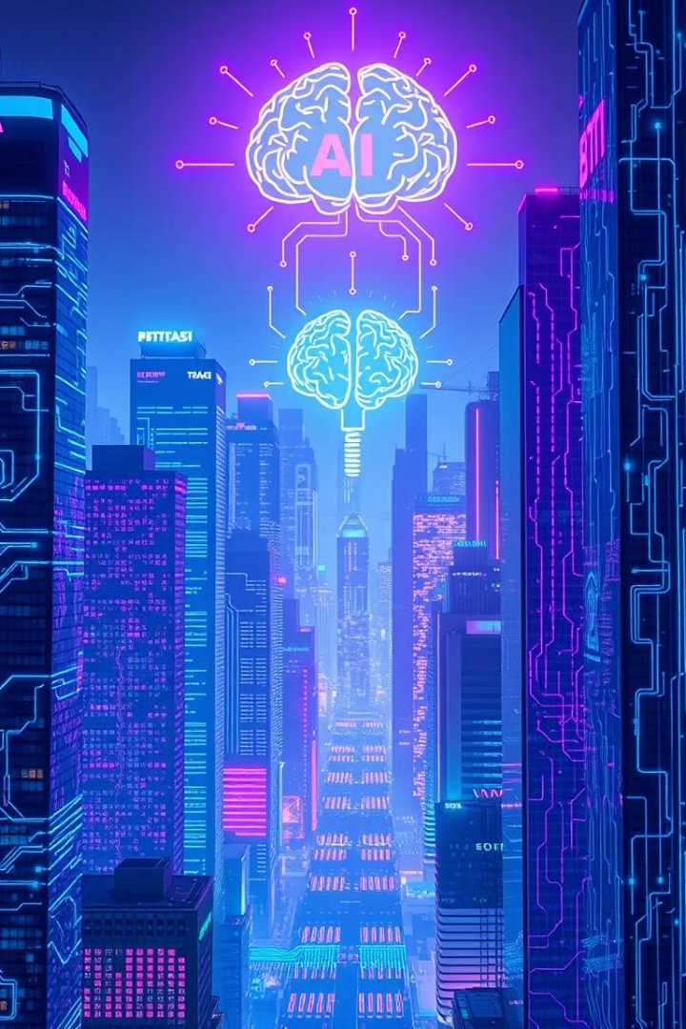

Data Science & AI: Transforming Industries
Join us as we explore the transformative power of data science and AI across various sectors.
Exploring impactful case studies
From exploration to platform scale
Embracing the future: Generative AI and federated learning
by nithyalakshmi M

Slide 2
Case Study 1: FinTech Fraud Detection
Challenge
Data Science
ML Models
AI Systems
$50B+ annual losses globally due to financial fraud.
Exploratory analysis to identify emerging fraud patterns.
Predictive algorithms trained on vast transaction data.
Real-time blocking for suspicious financial activity.

Slide 3

FinTech Fraud: Results & Impact
40%
25%
$15M+
Fraud Reduction
Faster Detection
Losses Prevented
Reduction in fraudulent transactions.
Improvement in detection times.
Saved in prevented financial losses.
These results demonstrate the significant impact of AI-driven fraud detection.

Slide 4





Case Study 2: Intelligent Personal Assistants
Goal
Seamless user experience through advanced NLP.
NLP Pipelines
Transforming voice commands into actionable data.
Deep Learning
Advanced models for natural language understanding.
Personalization
Tailored responses via behavioral data analysis.

Slide 5




Intelligent Assistants: Outcomes
30% Increase
20% Improvement
15% Boost
Boost in user engagement metrics.
Better task completion rates for users.
Positive customer feedback and satisfaction.
These outcomes highlight the success of AI in enhancing user interactions.

Slide 6

Case Study 3: Supply Chain Optimization
Challenge
Minimizing costs and maximizing logistical efficiency.
Simulation
Modeling complex logistics scenarios for analysis.
Forecasting Models
Accurate prediction of demand fluctuations.
Reinforcement Learning
Optimizing routing and inventory management decisions.
Result: A significant 15% reduction in overall supply chain costs.

Slide 7
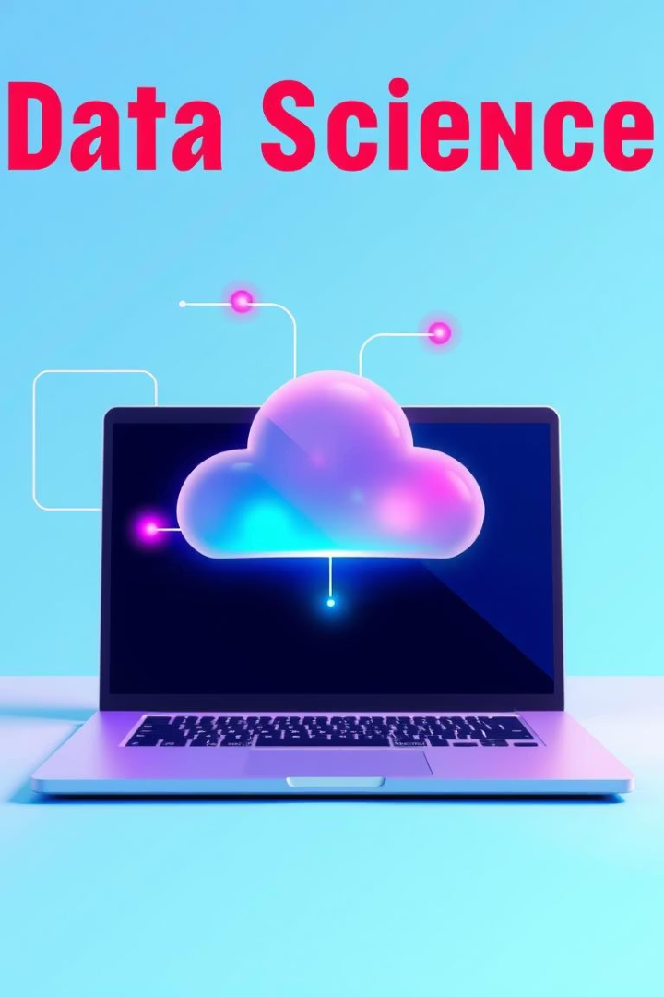
From Notebook to Platform: Scaling Data Science
Reusable Feature Stores
Data Contracts & Governance
Standardized and governed data assets for consistency.
Ensuring high data quality and regulatory compliance.
MLOps
Automating the entire machine learning lifecycle.
Scaling data science from individual notebooks to robust platforms is critical.

Slide 8




The Future: Generative AI & Federated Learning
Generative AI
Federated Learning
Synthetic data for enhanced model training.
Collaborative model building without data sharing.
These emerging trends will redefine data science and AI applications.

